Slide 1
Spotify Music Recommendation System
TSP- AI ML Fundamentals (Capstone Project)
Presented By:
LOKESH S – au810021214019
Guided By: Ramar Bose Sr. AI Master Trainer

Slide 2
OUTLINE
Problem Statement
Proposed System/Solution
Algorithm & Deployment
GitHub Link
Project Demo(photos / videos)
Conclusion
Future Scope
References

Slide 3
Problem Statement
The purpose of Spotify's music recommendation system is to provide users with customized song recommendations based on their musical preferences. By leveraging machine learning techniques and the extensive Spotify dataset, the system analyzes song properties like danceability, energy, and tempo to group songs into clusters based on shared features. By entering their favorite song and, optionally, specifying a preferred genre, users interact with the system. The system then produces lists of suggested songs that are carefully chosen and closely align with the user's tastes. The system's primary goals are accurate suggestion creation, efficient data analysis and preprocessing, user-friendly interface design, and scalability to handle large amounts of data. In addition, the system wants to improve its recommendation capabilities over time by adjusting to changing user preferences and providing more and better choices.

Slide 4
Proposed Solution
The suggested method creates customized music recommendations by using the Spotify tracks dataset that was obtained from Kaggle. Data points are arranged according to qualities like danceability, energy, and tempo using K-Means clustering, which makes it easier to find music with related features. To improve suggestion accuracy, users can indicate preferred genres and offer their favorite songs. Making use of the clustering approach, the system suggests songs from the user's preferred cluster, guaranteeing that it is in line with their taste in music. The recommender system is implemented as a regular Python application, which guarantees user accessibility. Spotify users' overall music discovery experience is improved by constant system improvement, which is fueled by user input and performance evaluations.

Slide 5
Algorithm & Deployment
• Data Analysis and Processing: Processing and analyzing the Spotify dataset to extract relevant features for recommendation.
• Machine Learning: Implementing the K-Means clustering algorithm for grouping songs into clusters based on their attributes.
• User Interface Design: Designing an interactive interface for users to input their favorite songs and preferred genres.
• Model Deployment: Deploying the recommendation system as a standalone Python application for user accessibility.
• Package Installation: Ensuring the availability and installation of required packages such as pandas, numpy, plotly, yellowbrick for data manipulation, visualizations, clustering respectively.

Slide 6
GitHub Link
https://github.com/lokesh0346/Spotify-recommendation-system

Slide 7
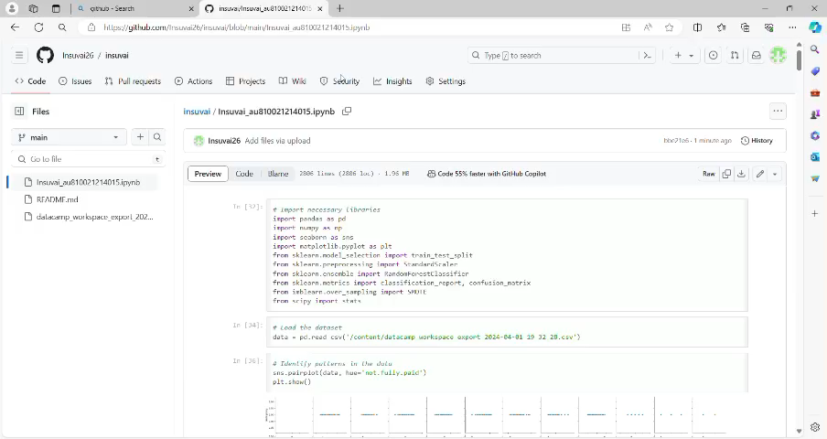
Project Demo(Recorded Video)

Slide 8
Conclusion
Users' experience of music discovery is being revolutionized by the Spotify Music Recommendation App, which is a ground-breaking combination of cutting-edge machine learning and user-centric design. Using methods like collaborative filtering, its advanced recommendation engine examines user data to create personalized recommendations that improve the listening experience. The app has been widely popular because to its smooth platform and device rollout, which has revolutionized personalized music discovery within the Spotify ecosystem.

Slide 9
Future Scope
Spotify's algorithm may investigate various machine learning techniques such as matrix factorization and deep learning in order to improve suggestion precision. These could better capture complex user preferences when combined with content-based recommendation and collaborative filtering. Adding social features and more sophisticated filtering tools to the interface would accommodate a wider range of user preferences and create a more personalized and interesting experience for music discovery. By utilizing item attributes and user behavior, collaborative and content-based filtering techniques could improve suggestion accuracy even more.

Slide 10
References
Project Github link, Ramar Bose , 2024
Project video recorded link (youtube/github), Ramar Bose , 2024
Project PPT & Report github link, Ramar Bose , 2024

Slide 11
THANK YOU

